Slide 1

An Overview Of
Maven Toys Store
2017 Sales
Group J - FSDA

Slide 2
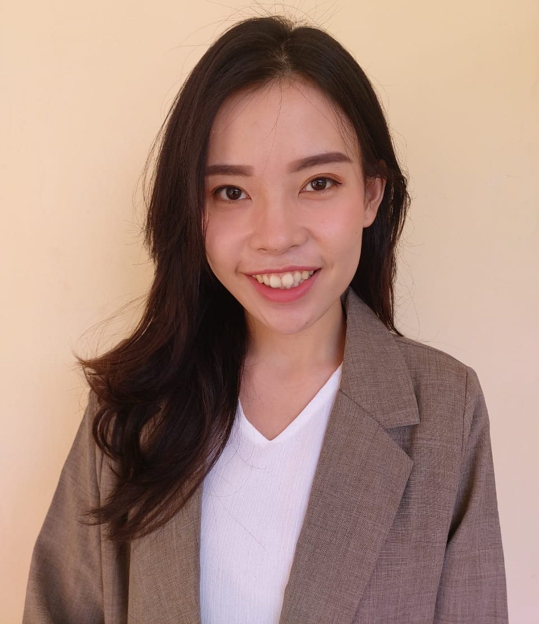



Meet Our Team
Natasia Angreani
Reynaldo Kurnia Gazali
Gabriella Sibarani
Project Leader
Muhammad Thareqky
Data Analyst Team
Data Analyst Team
Visualization Specialist

Slide 3
Table of Contents
01
Background
02
Data Exploration
03
Recommendation
04
Forecasting

Slide 4
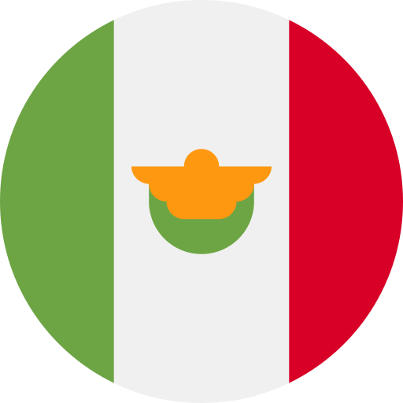

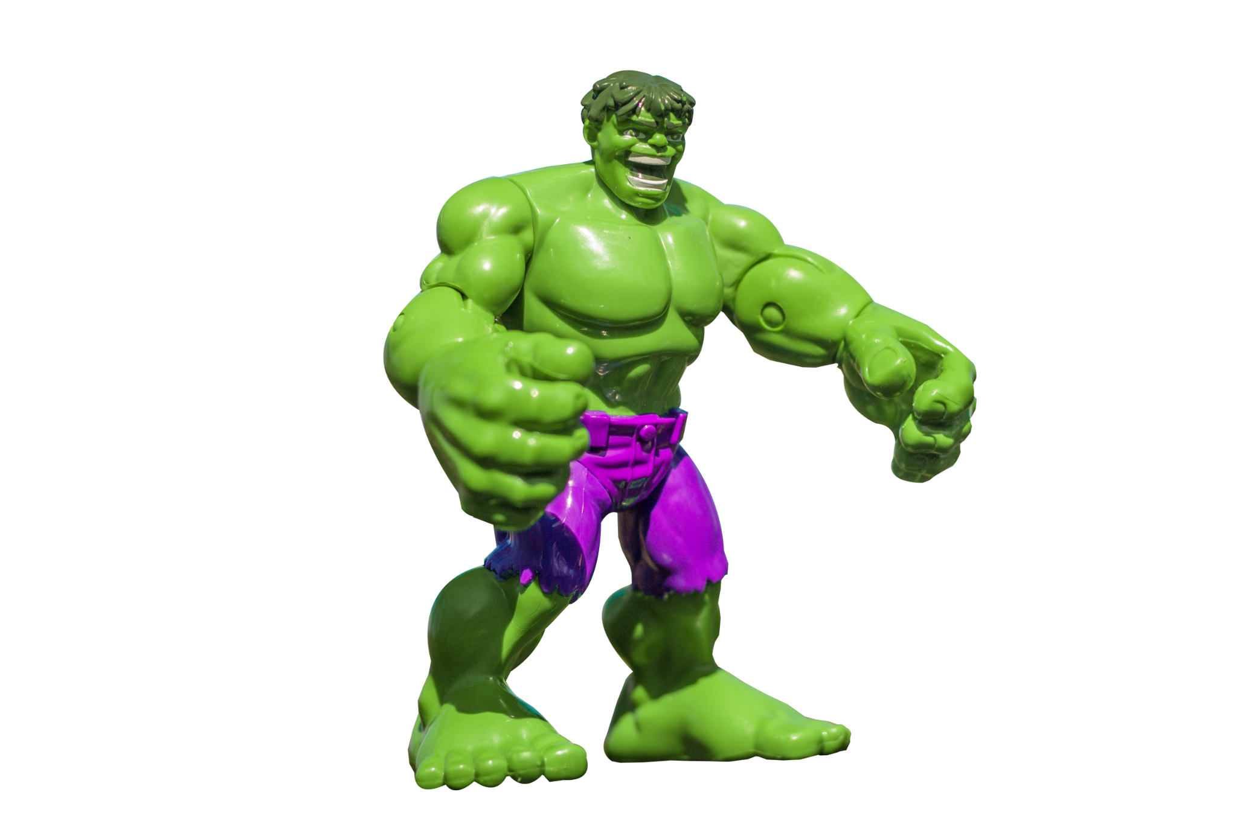
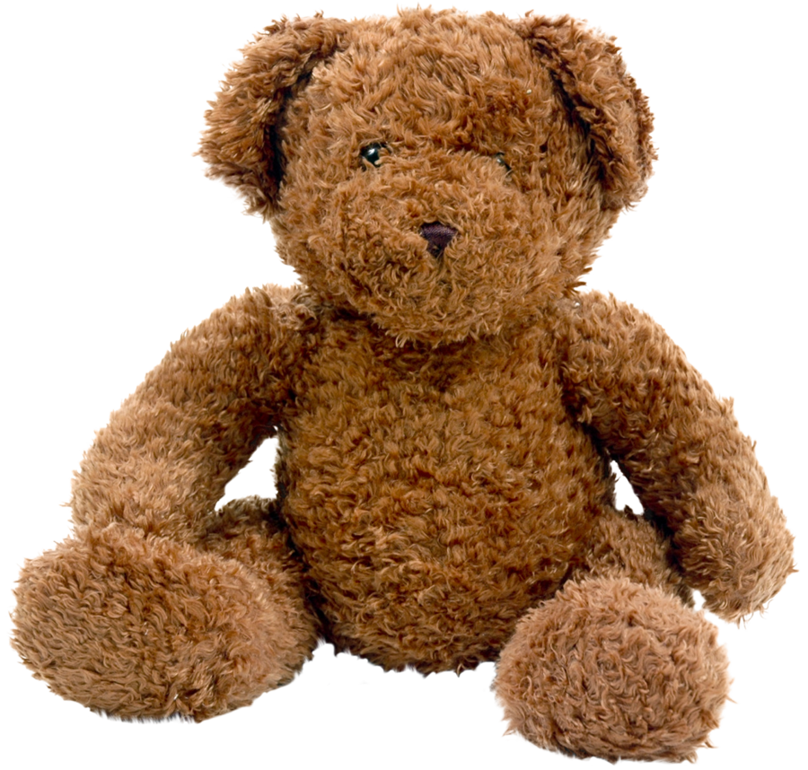



Maven Toys Store Overview in 2017
Total
50 stores
TOTAL PRODUCT
Product category
29 cities
5 product categories
arts & craft, toys, games, electronics, sports & outdoors
33 SKU
4 locations
REVENUE
$ 7,482,498 (MXN)
downtown, airport, commercial, residential
Notes:
Theme bg putih, coba variasi warna di font

Slide 5
Executive Summary
The company growth for 2017 was at 3.58 % CMGR.
Sales experienced stagnation throughout the year, with only slight spikes during the end of the year.
Sales had a 27% MoM growth from November to December, correlating with public and religious holiday (mainly Christmas).
Average revenue were 45% higher during weekends compared to weekdays.
Promotion strategies are suggested to focus on sales during weekends & boost sales during weekdays.
7 out of 29 cities contributed to 50% of revenue.
Events and promotions should be focused on the 7 cities & market research should be conducted on the rest to understand the segmentation better.
Notes:
Di shorten lagi, review lagi highlighting

Slide 6
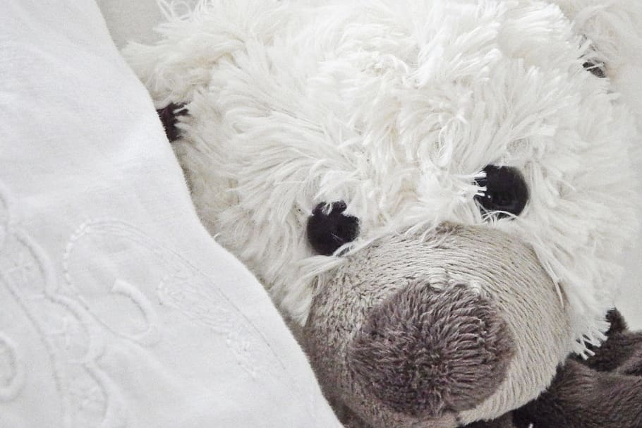
01
Background
Projected by 2024, Mexico’s toy market value could reach approximately 4.8 billion U.S dollars. Mexico was the second most valuable toy market in Latin America and will keep on increasing through times.
Source: https://www.statista.com/statistics/1030477/market-value-toys-mexico/
Notes:
Masukin source tas

Slide 7
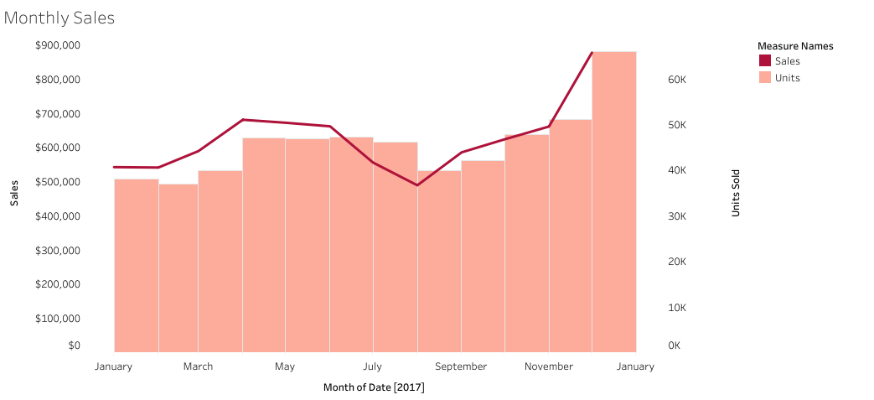
Maven Toys Store Sales Recap in 2017
■ Sales ■ Units Sold
Maven Toys Store sales experienced stagnation during the the first and middle half of 2017 and increasing slightly during December 2017.
Notes:
Berikut recap penjualan MTS di 2017, bisa kita lihat terjadi stagnasi di awal hingga pertengahan tahun & ada kenaikan pada Desember/ akhir tahun

Slide 8
Scope of Problems
Goals
Learning from the 2017 stagnation, Maven Toys Store need to overcome this in 2018 by generating new sales strategy.
To increase 15% of revenue by the end of 2018
MAVEN TOYS STORE
Notes:
highliting

Slide 9
Methodology
#1 Data Gathering
#3 Analyze Data
#5 Insights
Provide recommendation from data analysis
Data cleaning & EDA using python to find the right insights
Gathering historical data
#4 Data Visualization
#2 RCA
Conducting root cause analysis
Creating deck & dashboard
Notes:
Explore executive summary

Slide 10

02
Data Exploration

Slide 11
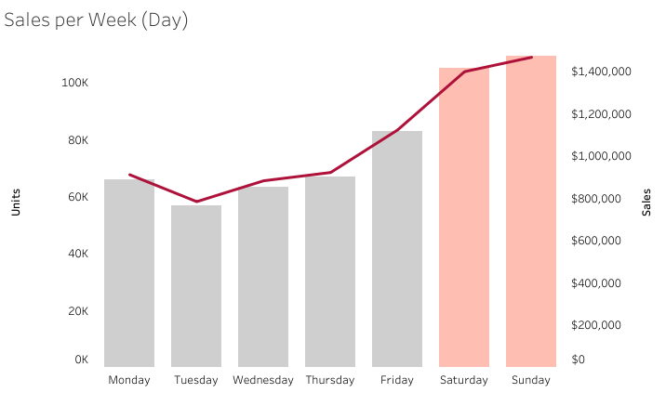
Maven Toys Store generates higher revenue on the weekend, the sales are lower during weekdays.
The Maven Toys Store consumer behavior could be seen through the average of weekends revenue that were 45% higher than weekdays.
Notes:
Berdasarkan hasil analisis, kami menemukan bahwa penjualan dan revenue yang dihasilkan pada weekend lebih tinggi dibandingkan weekdays.
Perbedaan penjualan mencapai 45% lebih tinggi pada weekend

Slide 12
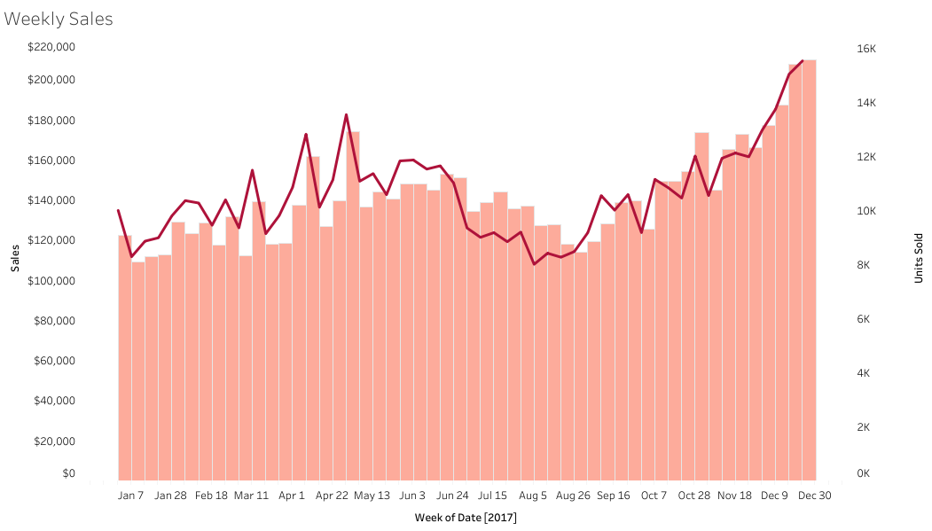
Maven Toys Stores revenue had a significant increase in April and reached its peak in December.
From a yearly view:
The increment is possibly related to Children’s day in April and Christmas in December
The revenue declined in August, possibly related with the 2017 Atlantic hurricane season and the start of school year.
■ Sales ■ Units Sold
Notes:
Jika dilihat dari penjualan mingguan selama tahun 2017, kita bisa lihat bahwa peningkatan signifikan terjadi pada bulan April dan Desember.
Hal ini dikarenakan pada bulan April terdapat perayaan Children’s Day dan pada bulan Desember ada perayaan Natal.
Kita jg bs lihat bahwa terdapat penurunan penjualan di bulan Agustus, hal ini dapat disebabkan oleh adanya hurricane atlantic di bulan Agustus. Bulan Agustus juga bertepatan dengan tahun ajaran baru sekolah di Mexico.

Slide 13
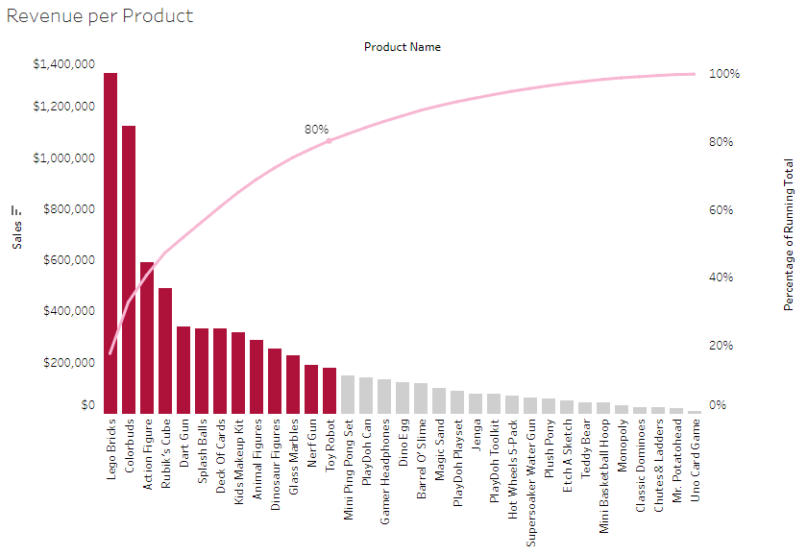
80% of Maven Toys Store revenue was generated by these 13 products
■ Sales
■ Percentage of Running Total
MTS should stock up on the top 13 products that generate highest revenue.
Out of 13 products, 3 products contributed a significant amount of revenue: Lego bricks, Colorbuds, & Action figure.
Notes:
Hasil analisa lebih lanjut juga menunjukkan bahwa 80% dari pendapatan tahun 2017 merupakan hasil penjualan dari 13 product berikut.
Kita merekomendasikan MTS untuk memperbanyak persediaan/ stock 13 product ini.

Slide 14
Maven Toys Store Product Clustering
Fast
Moderate
Slow
Monthly unit sold per store > 50 units
There are 7 products in this category
Made up 52% of total sales
Monthly unit sold per store between 28-50 units
There are 5 products in this category
Monthly unit sold per store < 28 units.
There are 21 products in this category
Notes:
Kita juga bisa mengelompokkan product2 MTS ke dalam 3 kategori, berdasarkan throughput/ tingkat penjualannya, yaitu fast, moderate, & slow.
Kategori fast adalah produk2 yg terjual > 50 unit/ month, moderate 28-50 unit/ month, slow < 28 unit per month

Slide 15
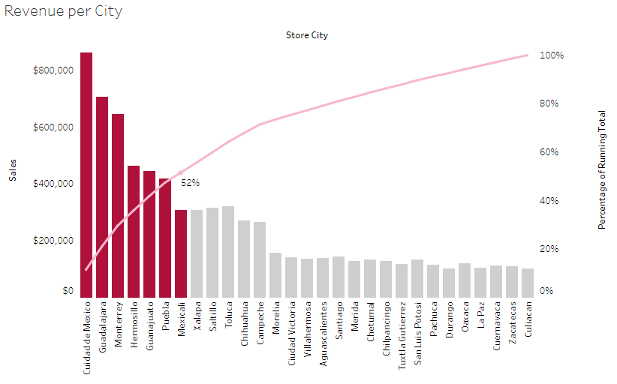
50% of Maven Toys Store revenue was generated by the stores that located in these 7 cities.
■ Sales ■ Percentage of Running Total
Revenue could be affected by the # of population from each cities.
These are the list of top 3 cities that generated most revenue: Cuidad de Mexico, Guadalajara, Monterrey.
Maven Toys Stores could conduct more event/campaign/promotion on the store in those cities.
For cities with lower revenue Maven Toys need to conduct further research on the market segment.
Notes:
Berdasarkan hasil analisis, kita jg menemukan bahwa 50% dari pendapatan MTS dimotori oleh penjualan di 7 kota saja.
Tp perlu dinote jg bahwa kota2 ini merupakan kota dengan kepadatan penduduk yang lebih tinggi.
Kita bisa merekomendasikan MTS untuk memfokuskan promosi di kota2 ini melalui campaign/ event.

Slide 16
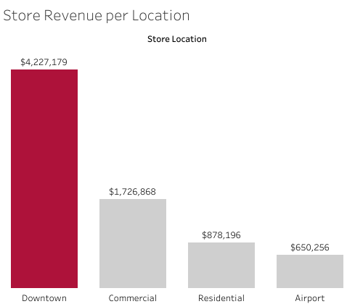
From each cities the downtown stores generates highest total revenue
Stores located in the downtown had generated the highest total revenue in 2017.
This might have happened because downtown has the highest amount of stores.
Notes:
Td sudah sempat dimention bahwa MTS buka di 4 kategori lokasi yaitu downtown, commercial, residential, & airport
Findings dari kita adalah revenue tertinggi dihasilkan oleh toko2 di lokasi downtown. Tp perlu dinote bahwa lokasi dowtown punya # toko yang paling banyak.

Slide 17
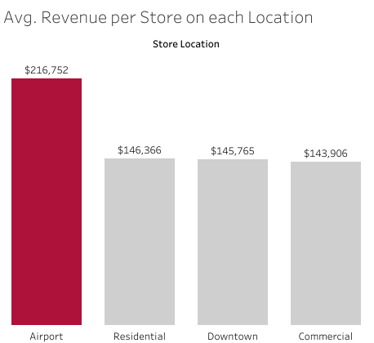
Looking at the average sales per store on each location, airport stores have the highest average sales
Despite having the least number of stores, Airport locations have the highest average revenue.
We can consider expanding to airports in other cities.
Notes:
Tapi jika dilihat dari pendapatan rata2 per toko di tiap lokasi, kita bisa lihat bahwa toko di airport memiliki rata2 tertinggi, walaupun dengan jumlah toko yang paling sedikit.
Berdasarkan temuan ini, kita jg bisa recommend ekspansi ke bandara2 di kota2 lain.

Slide 18
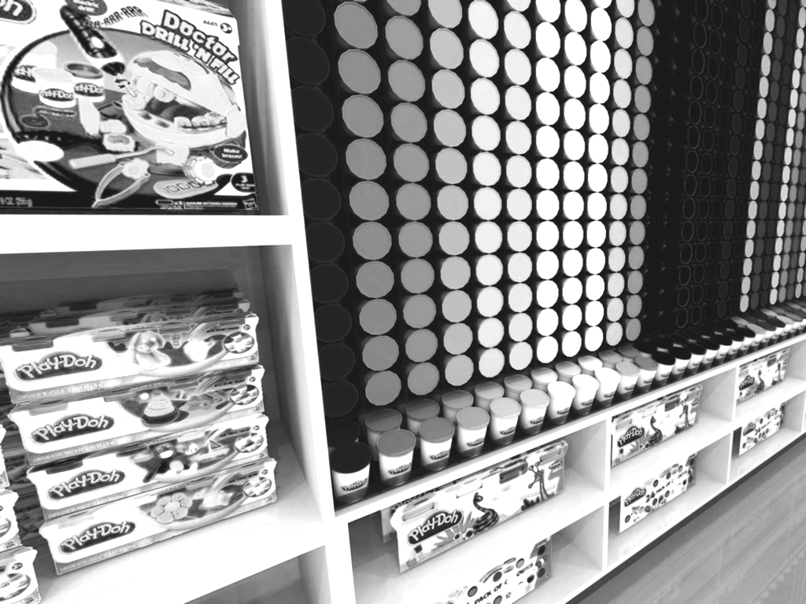
03
Recommendation

Slide 19
SHORT TERM RECOMMENDATION
01
Increasing Weekend Sales
Targeted promotions on weekends.
Cashbacks & vouchers for 2nd purchases during weekends.
02
Increasing Weekday sales
Happy hour promotions on weekdays to increase weekday sales.
Promo for customers who bring student ID & wearing school uniform on weekdays.
03
Boosting Year End & Public Holiday sales
Campaign & events on year end and public holiday (Christmas, Children’s Day & Independence Day).
04
Increasing sales for slow moving products
Bundling promo for slow moving products, pairing it with fast moving products.
Display slow and moderate moving products more prominently (main shelf)
Give training and incentivize the staff to attract more customer to buy slow moving product
05
Boosting sales on cities that generate 50% of the revenue
Participating in city-wide events or festivals
Notes:
1. Increasing the stores in certain areas will increase the revenue
2. Bundling low moving products with fast moving products will generate more revenue
3.Boosting sales on products that generates 80% of revenue
4. Add more products that generates more revenue

Slide 20
LONG TERM RECOMMENDATION
01
Expanding to more productive areas
Opening stores in more productive & higher revenue-generating area, which is airport.
02
Adding more product & product categories
Conduct annual market research to adapt with the current toys demand.
03
Consolidate stores in lower performing cities
Conducting market research on lower performing cities to understand the appetite.
Notes:
1. Increasing the stores in certain areas will increase the revenue
2. Bundling low moving products with fast moving products will generate more revenue
3.Boosting sales on products that generates 80% of revenue
4. Add more products that generates more revenue
Bullet point

Slide 21
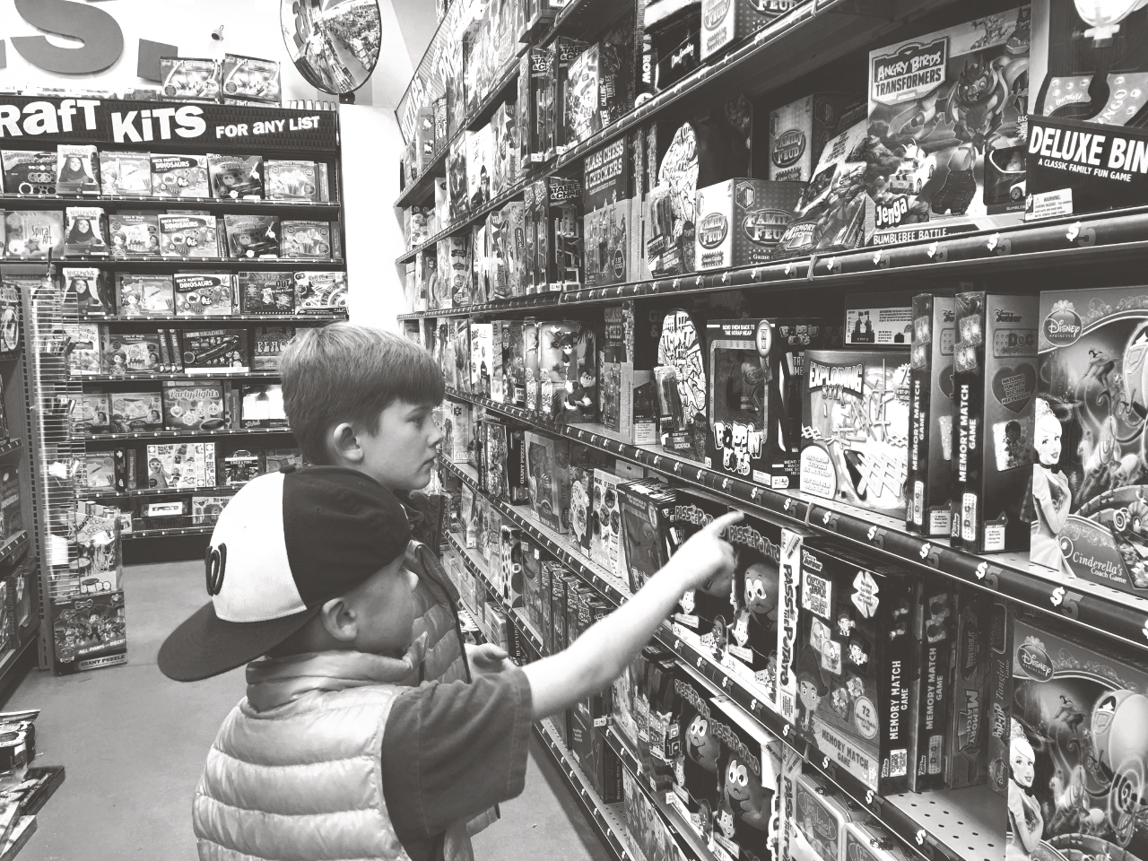
04
Forecasting

Slide 22
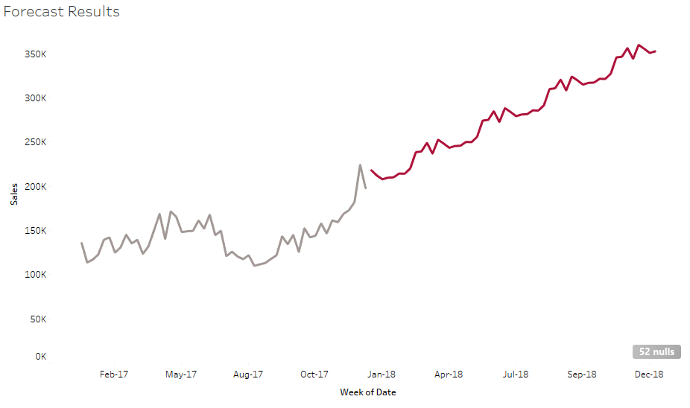
Based on the 2017 sales, Maven Toys Store sales are projected to have a positive growth.
2017
2018
■ Sales
■ Estimated Sales
Notes:
Di split with garis

Slide 23
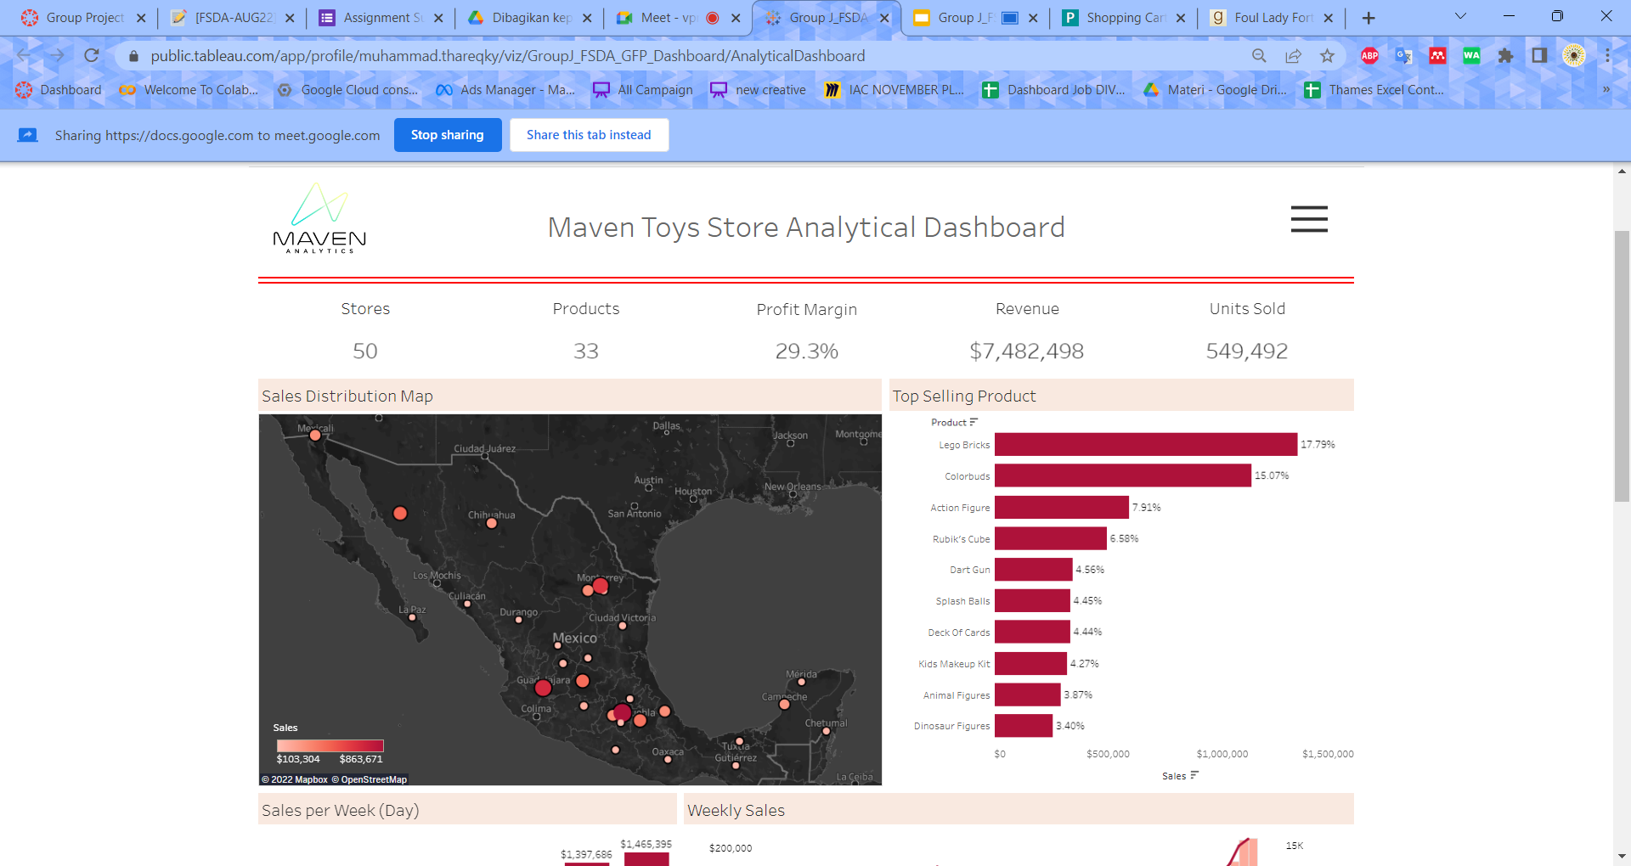
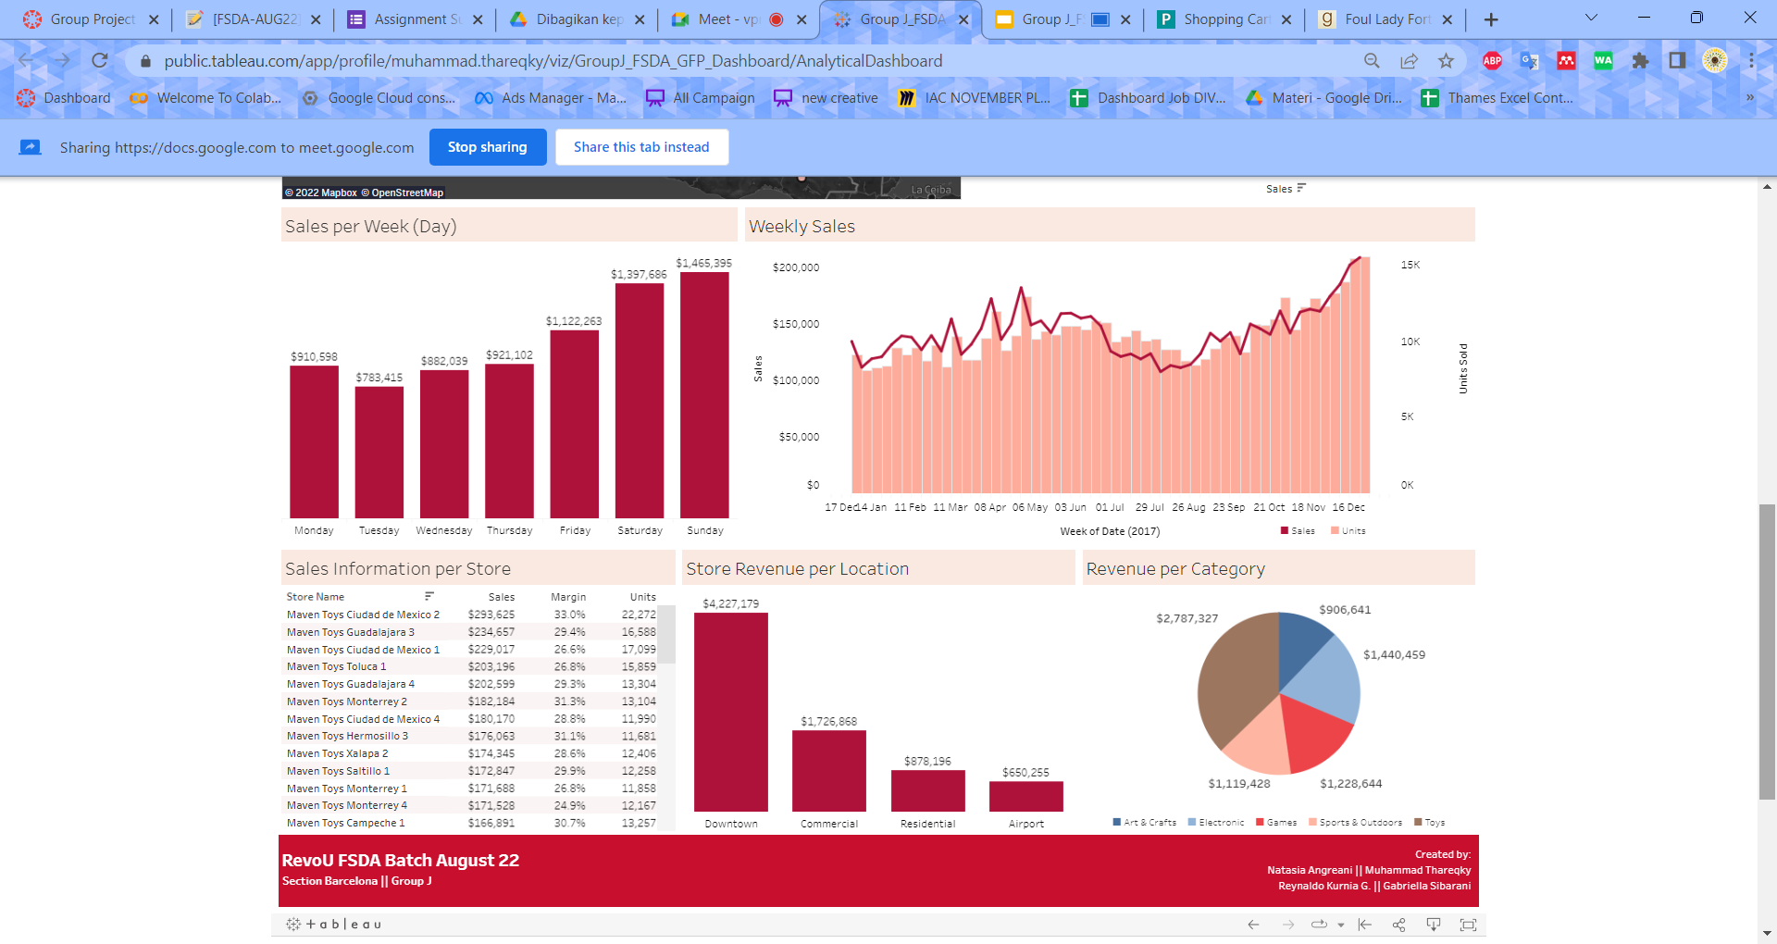
Dashboard Snapshot

Slide 24
Appendix
Dataset: https://www.mavenanalytics.io/data-playground?page=3
Dashboard: https://public.tableau.com/app/profile/muhammad.thareqky/viz/GroupJ_FSDA_GFP_Dashboard/AnalyticalDashboard
Python: https://colab.research.google.com/drive/1ocXIj2yvNRJVuSKoboW-jlF6UytlCd1P?usp=sharing
External Resources:
https://www.statista.com/statistics/1030477/market-value-toys-mexico/
https://www.kaggle.com/code/sumi25/understand-arima-and-tune-p-d-q/notebook
https://www.kaggle.com/code/abdrakhmanmurat/time-series-eda-sarimax-mexico-toy-sale

Slide 25

Thank you

